Slide 1

Kommune-kampen
A STUDY OF THE NEW 2020 MUNICIPALITIES OF NORWAY

Slide 2
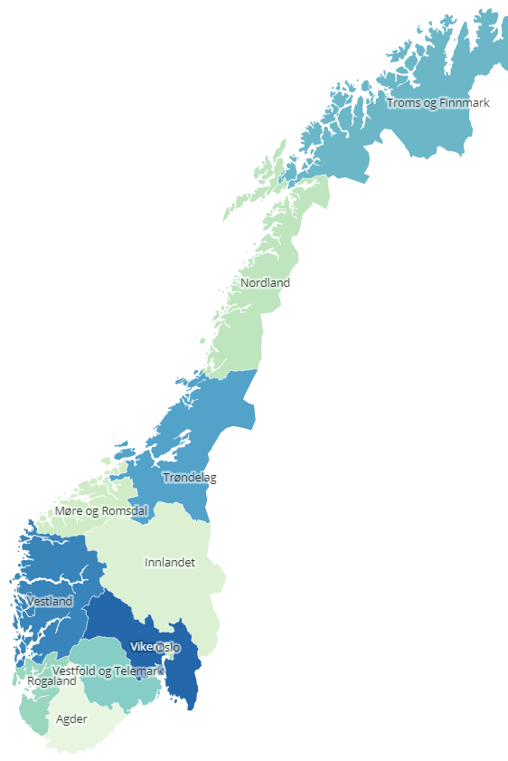
Background
On January 1st 2020 the number of counties in Norway was redused from 19 to 11, while the number of municipalities was reduced from 428 to 354.
With the relatively small population of Norway, the amount of venues in the different municipalities varies a lot.
In this project I found and scraped the coordinates and population data of the municipalities of Norway. I used data from Foursquare to compare venues in the municipalities and clustered the municipalities using the venue results.

Slide 3
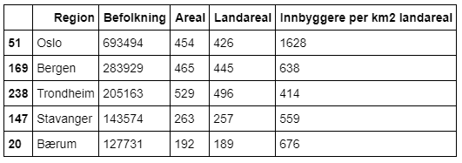
Largest population

Slide 4
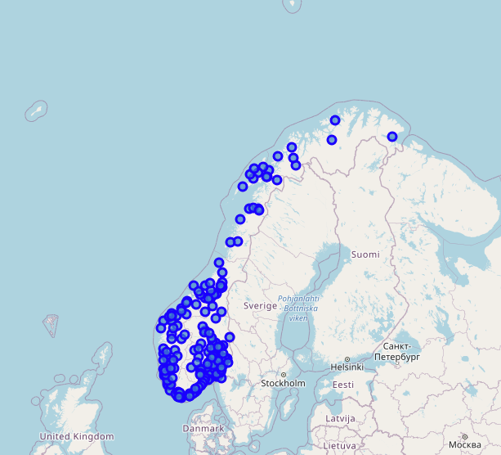
Location data

Slide 5
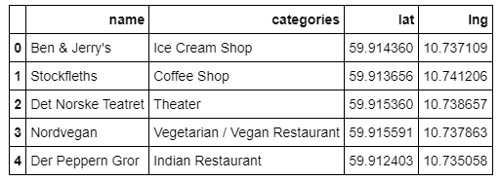
Top 5 venues of Oslo

Slide 6
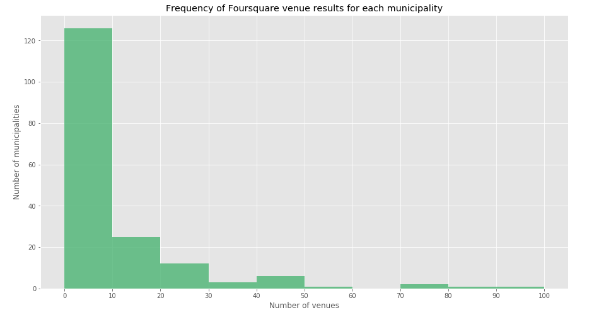
Foursquare venue results

Slide 7
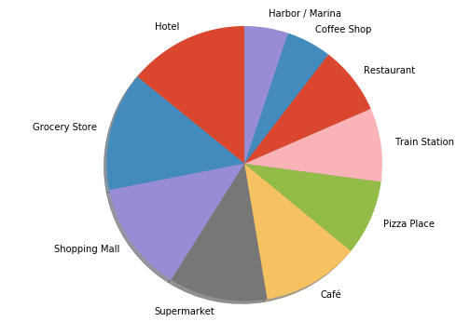
Most common venues in Norway

Slide 8
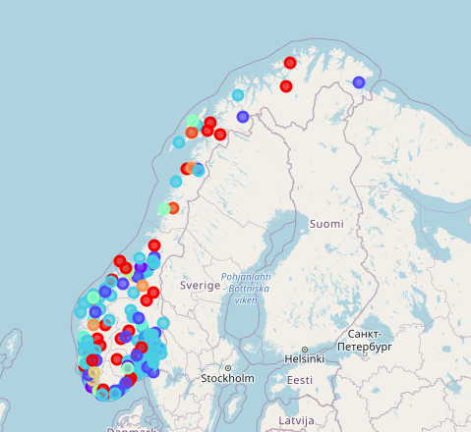
Clustering based on venues

Slide 9
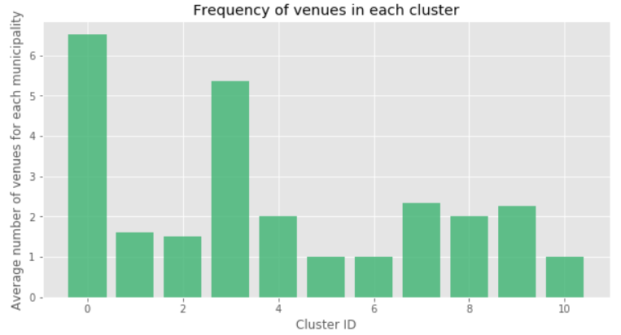
Average number of venues

